Slide 1
ISP Goals Session

Slide 2
Land Acknowledgement
Notes:
Insert a relevant image above and provide a land acknowledgment.
You can refer to the following resources to help you develop your own land acknowledgment:
Respect, Sincerity & Responsibility: Land Acknowledgements @ UBC: https://wpl.ubc.ca/browse/professional-development/courses/wpl-pd-rsr
UBC Wiki, Land Acknowledgements in Teaching and Learning: https://wiki.ubc.ca/Documentation:Inclusive_Teaching/Land_Acknowledgements_in_Teaching_and_Learning
Indigenous Peoples: Language Guidelines Version 3.0: http://assets.brand.ubc.ca/downloads/ubc_indigenous_peoples_language_guide.pdf

Slide 3




Community Agreements
Insert Agreement
Insert Agreement
Insert Agreement
Insert Agreement
Notes:
Provide a list of community agreements to ensure participants engage in safe, respectful, and meaningful conversations.
Below are some examples:
1. No one knows everything, but together we know a lot.
2. Intent does not equal impact.
3. Our best is better than perfect.
4. Step up and step back.
5. Mistakes are okay
Feel free to use (or not use) the examples above and add your own agreements.

Slide 4
Goals for today

Slide 5
ISP Self-Assessment Tool Overview
[Enter # of respondents to the ISP Self-Assessment Tool]
Areas where we feel we are aligned with the ISP and Self-Assessment Tool statements include:
  [Insert key areas of alignment here – may need additional slides]

Slide 6
ISP Self-Assessment Tool Overview
We feel less aligned with the ISP and Self-Assessment Tool statements relating to:
  [Insert key areas of dis-alignment here – may need additional slides]

Slide 7
ISP Self-Assessment Tool Overview
There were divergent/diverse responses to the following Self-Assessment Tool statements:
  [Insert info/data where respondents' were bi-modal or spread]

Slide 8
Understanding our Mandate
[It can be helpful to have leadership review the mandate of the unit/department and how that connects to various goals/actions within the ISP]

Slide 9
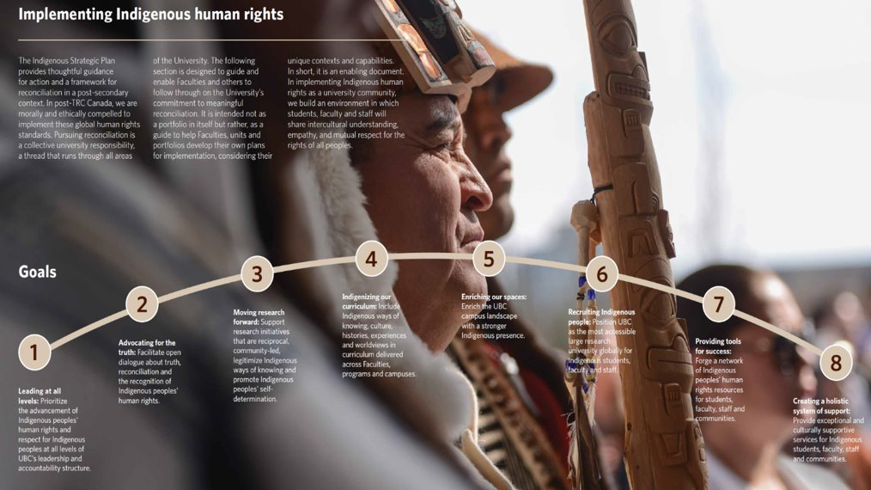
ISP Goals

Slide 10
Reviewing the ISP Goals
To begin with, let's focus on how our day-to-day work aligns with the ISP.
Prompt: In thinking about the work you do on a daily basis, how directly is are your role and responsibilities related to this ISP Goal?

Slide 11
Goal 1: Leading at all levels
“Prioritize the advancement of Indigenous peoples’ human rights and respect for Indigenous peoples at all levels of UBC’s leadership and accountability structure”
Relationship | ​Please use a stamp/check to indicate what level of relation your work has to the statement above
Strongly Related
Related​ | ​
Unsure​ | ​
Unrelated​ | ​
Strongly Unrelated​ | ​

Slide 12
Goal 2: Advocating for the truth
“Facilitate open dialogue about truth, reconciliation and the recognition of Indigenous peoples’ human rights.”
Relationship | ​Please use a stamp/check to indicate what level of relation your work has to the statement above
Strongly Related
Related​ | ​
Unsure​ | ​
Unrelated​ | ​
Strongly Unrelated​ | ​

Slide 13
Goal 3: Moving research forward
“Support research initiatives that are reciprocal, community-led, legitimize Indigenous ways of knowing and promote Indigenous peoples’ self-determination.”
Relationship | ​Please use a stamp/check to indicate what level of relation your work has to the statement above
Strongly Related
Related​ | ​
Unsure​ | ​
Unrelated​ | ​
Strongly Unrelated​ | ​

Slide 14
Goal 4: Indigenizing our curriculum
“Include Indigenous ways of knowing, culture, histories, experiences and worldviews in curriculum delivered across Faculties, programs and campuses.”
Relationship | ​Please use a stamp/check to indicate what level of relation your work has to the statement above
Strongly Related
Related​ | ​
Unsure​ | ​
Unrelated​ | ​
Strongly Unrelated​ | ​

Slide 15
Goal 5: Enriching our spaces
“Enrich the UBC campus landscape with a stronger Indigenous presence.”
Relationship | ​Please use a stamp/check to indicate what level of relation your work has to the statement above
Strongly Related
Related​ | ​
Unsure​ | ​
Unrelated​ | ​
Strongly Unrelated​ | ​

Slide 16
Goal 6: Recruiting Indigenous people
“Position UBC as the most accessible large research university globally for Indigenous students, faculty and staff.”
Relationship | ​Please use a stamp/check to indicate what level of relation your work has to the statement above
Strongly Related
Related​ | ​
Unsure​ | ​
Unrelated​ | ​
Strongly Unrelated​ | ​

Slide 17
Goal 7: Providing tools for success
“Forge a network of Indigenous peoples’ human rights resources for students, faculty, staff and communities.”
Relationship | ​Please use a stamp/check to indicate what level of relation your work has to the statement above
Strongly Related
Related​ | ​
Unsure​ | ​
Unrelated​ | ​
Strongly Unrelated​ | ​

Slide 18
Goal 8: Creating a holistic system of support
“Provide exceptional and culturally supportive services for Indigenous students, faculty, staff and communities.”
Relationship | ​Please use a stamp/check to indicate what level of relation your work has to the statement above
Strongly Related
Related​ | ​
Unsure​ | ​
Unrelated​ | ​
Strongly Unrelated​ | ​

Slide 19
Where does our mandate align?
Leading at all levels
Advocating for truth
Moving research forward
Indigenizing our curriculum
Enriching our spaces
Recruiting Indigenous people
Providing tools for success
Creating a holistic system of support

Slide 20
Moving forward
Use this space to discuss what ISP goals have the best alignment with the work of the department/unit
Discuss next steps for engagement and where focus should be

Slide 21
Thank you
Feel free to reach out to [names] with any questions or feedback. We'll be in touch about upcoming sessions and opportunities.

Slide 22




This work is licensed under a Creative Commons Attribution-NonCommercial-ShareAlike 4.0 International License.

